Slide 1
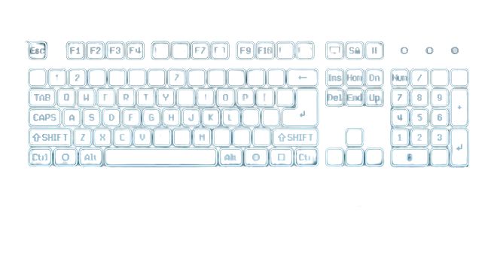


Product Design
Ryudzay R-1
Muhandis Lawdza’I Putra Sanjaya
Rizq Syandana Dwi Anggara
Ayub Abdullah

Slide 2
Problem

Slide 3

Problem
Keyboards are generally difficult to carry anywhere and are inefficient when carried because they narrow the luggage

Slide 4
Virtual Keyboard Definition

Slide 5
Virtual Keyboard Definition
The virtual keyboard is an invention that allows it to be an alternative among the traditional keyboard rotation.
The basic difference between the virtual keyboard and the traditional keyboard. is a virtual keyboard displayed on a flat surface whereas a traditional keyboard has a physical form that you can hold in your hand. So you type directly on the keyboard to enter the command you want.

Slide 6
Solutions to solve problems

Slide 7
Solutions to solve problems
Practical
Multi-function
Modern & Futuristic

Slide 8
Student College
Office Employees
Marketing Targets

Slide 9
VK Spesifications

Slide 10
02
01
03
Virtual Keyboard Specifications
04
06
05
Color Keyboard
Battery
RYG
Connection with
4000mAh
(About 12 hours)
Bluetooth 5.0
Speaker
Projection size
Stereo
Product Size
10cm x 25cm
9cm x 4,8cm x 4,4cm

Slide 11
Product Picture

Slide 12
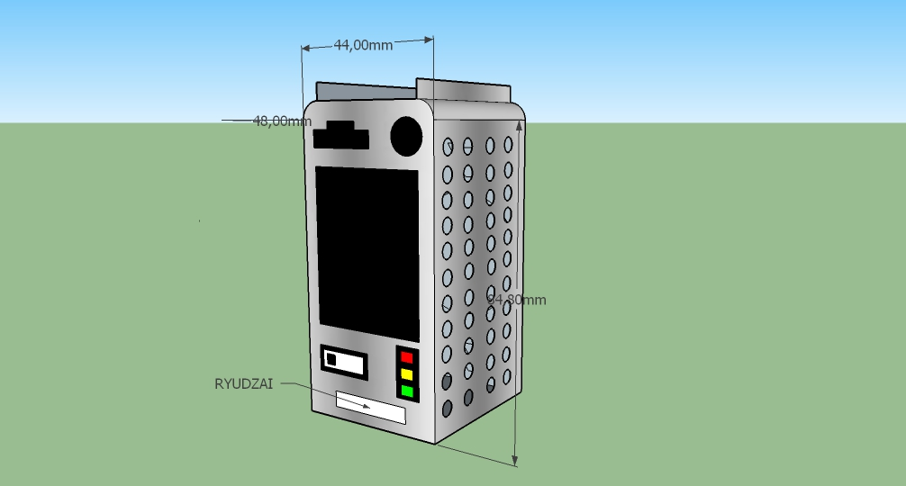
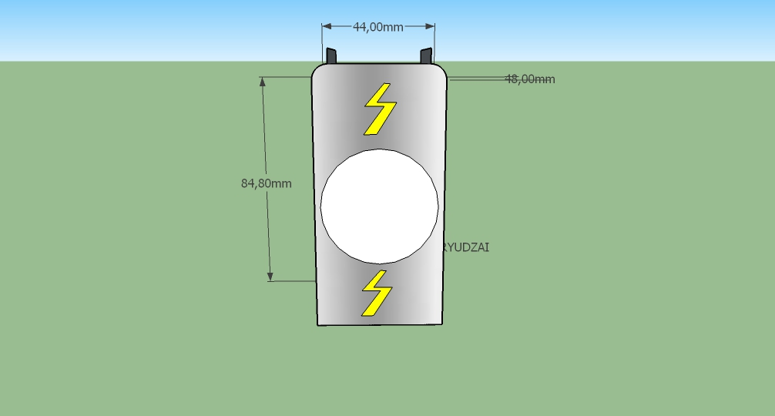
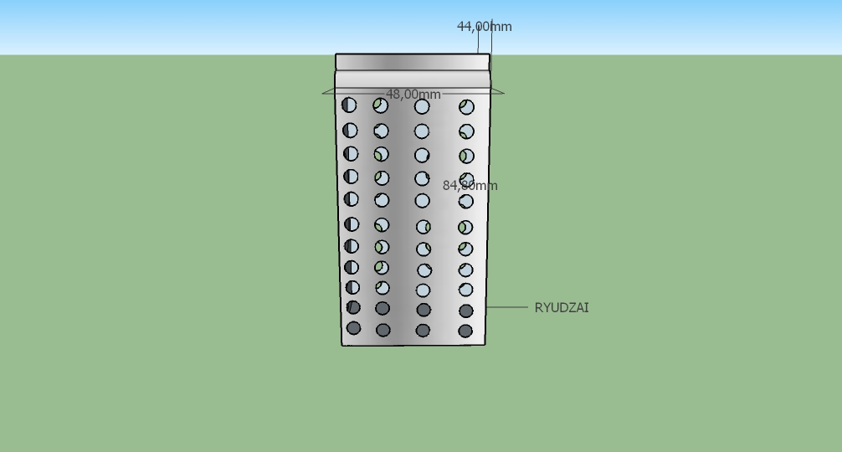
front
Behind
Beside

Slide 13
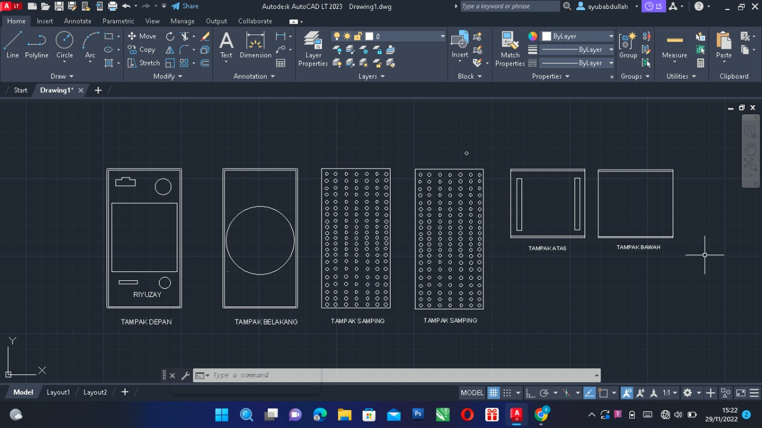
2D Picture

